Slide 1
GPGPU: what it is and why you should care
Alexander Titov

Slide 2



About me
Alexander Titov
Hardware Architect
11 years of C++ experience (HW simulation)
Teaching Computer Architecture and Design
alexander.titov@atitov.com
alexander-titov-cpu

Slide 3
Preface
GPGPU is performing General-Purpose computation on Graphics Processing Units (GPU) instead of CPU
Goal is to understand the basics of GPGPU that are common for all the HW vendors and for all the SW APIs
This talk is not…
a proper intro to CUDA, OpenCL, SYCL or any other framework
a discussion on what HW vendor is better, what API is better, etc.
able to make you a good GPGPU programmer

Slide 4

GPGPU Myths (?)
GPU is killing CPU
GPU will make your applications 1000x faster
GPU HW is “magic” and it is very different from CPU HW
GPGPU API (e.g., CUDA) is “magic”. It is much easier to write high-performance code for GPU than for CPU

Slide 5
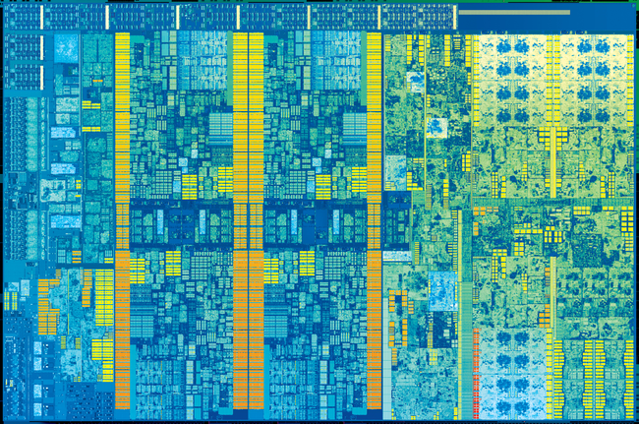
Why GPGPU?
GPU dramatically accelerates some general-purpose applications compared to CPU
dramatically
some
Core 0
Core 1
GPU is already everywhere
Desktops, laptops, mobile…
not servers (yet)
GPU is not a second-class citizen
GPU area ≥ CPU area
General Purpose
(CPU)
Graphics
(GPU)
Core 2
Core 3
Core i5-7400T, Kaby Lake, Jan 2017
Gen9 GT2 <- the smallest GPU configuration

Slide 6
CPU Evolution
Extremely simple: one instruction at a cycle, everything is in order
No parallelism
Fetch and Decode
F/D
Registers
R
A
ALU
In Order

Slide 7
CPU Evolution
Single-Instruction-Multiple-Data (SIMD) operations to leverage Data Level Parallelism (DLP)
Example of a SIMD operation:
B[0] = add A[0], 1
F/D
SIMD registers
B[1] = add A[1], 1
F/D
R
B[0:3] = vadd A[0:3], 1
R
SIMD operations
B[2] = add A[2], 1
A
A
B[3] = add A[3], 1
In Order
In Order
SIMD (DLP)

Slide 8
CPU Evolution
SuperScalar approach: if two (or more) consecutive instructions are independent, execute them in parallel
A very limited solution to exploit Instruction Level Parallelism (ILP)
F/D
F/D
F/D
R
R
R
A1
additional ALU
A
A
A0
In Order
In Order
In Order
SIMD (DLP)
SIMD (DLP)
SuperScalar (ILP)

Slide 9
CPU Evolution
Memory access latency is becoming a problem
Adding HW Caches and prefetch to mitigate it
F/D
F/D
F/D
R
F/D
R
R
A1
R
A1
A0
HW Cache
A
A
A0
$
In Order
In Order
In Order
In Order
SIMD (DLP)
SIMD (DLP)
SIMD (DLP)
SuperScalar (ILP)
SuperScalar (ILP)
Caches

Slide 10
CPU Evolution
Use sophisticated HW to extract more ILP by executing independent instruction out-of-order
BP
Branch prediction
F/D
OOO
Out-of-order scheduler
F/D
R
F/D
F/D
R
A0
A1
A2
F/D
R
R
A1
L1
R
A1
A0
L2
A
A
A0
$
In Order
In Order
In Order
In Order
Out-of-order (ILP)
SIMD (DLP)
SIMD (DLP)
SIMD (DLP)
SIMD (DLP)
SuperScalar (ILP)
SuperScalar (ILP)
SuperScalar (ILP)
Caches
Caches

Slide 11
CPU Evolution
single-thread
multi-thread
Adding another thread(s) to execute while the first thread is stalled
t0
t1
BP
BP
F/D
F/D
1x
OOO
OOO
1.5x
1.5x
F/D
R
R
F/D
F/D
R
A0
A1
A2
A0
A1
A2
F/D
R
R
A1
L1
L1
R
A1
A0
L2
L2
A
A
A0
$
1x
Multi-Thread (TLP)
In Order
In Order
In Order
In Order
Out-of-order (ILP)
Out-of-order (ILP)
SIMD (DLP)
SIMD (DLP)
SIMD (DLP)
SIMD (DLP)
SIMD (DLP)
throughput is higher,
but each thread is slower
SuperScalar (ILP)
SuperScalar (ILP)
SuperScalar (ILP)
SuperScalar (ILP)
Caches
Caches
Caches

Slide 12
CPU Evolution
t0
t1
tN-1
tN
Occupy available area by many cores
t0
t1
BP
BP
F/D
F/D
BP
BP
OOO
OOO
F/D
F/D
R
…
R
OOO
OOO
A0
A1
A2
A0
A1
A2
R
R
L1
L1
F/D
L2
L2
F/D
F/D
R
A0
A1
A2
A0
A1
A2
F/D
R
R
A1
L1
L1
L3
R
A1
A0
L2
L2
A
A
A0
$
Multi-Thread (TLP)
Multi-Thread-Core (TLP)
In Order
In Order
In Order
In Order
Out-of-order (ILP)
Out-of-order (ILP)
Out-of-order (ILP)
SIMD (DLP)
SIMD (DLP)
SIMD (DLP)
SIMD (DLP)
SIMD (DLP)
SIMD (DLP)
SuperScalar (ILP)
SuperScalar (ILP)
SuperScalar (ILP)
SuperScalar (ILP)
SuperScalar (ILP)
Caches
Caches
Caches
Caches

Slide 13
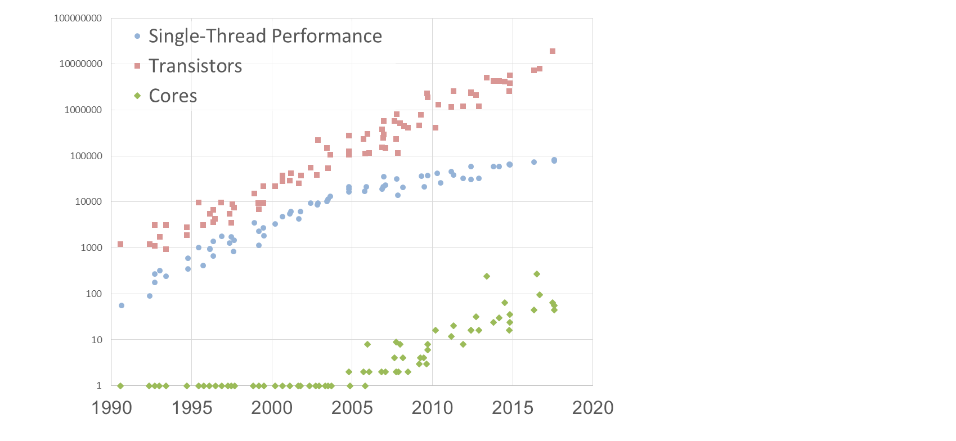

CPU Evolution: Performance Trends
About 5-10% of applications are well scaled
10⁸
→ need many simple cores
10⁷
Majority of applications cannot utilize more than 4-8 cores
10⁶
10⁵
→ need a few large cores
10⁴
Cannot optimize CPUs for 5-10% applications
Need to develop another device?
10³
10²
10¹
→ No, it is already available
1
Myth: GPU is killing CPU
Data up to 2010 collected by M. Horowitz, F. Labonte, O. Shacham, K. Olukotun, L. Hammond, and C. Batten. Data for 2010-2017 by K. Rupp

Slide 14
GPU Evolution (toward GPGPU)
Initially, GPU was designed strictly for rendering 2D and 3D
Graphic pipeline was fixed and could not be programmed
Graphic Pipeline
Non-Programmable

Slide 15
GPU Evolution (toward GPGPU)
Impossible to create special HW for all the demanded rendering functionality → programmability is needed
What is a typical rendering task?
the same actions on multiple independent elements (e.g., turn pixels color to gray)
processing time of a single element is not important, only total time matter
→ it is SIMD!
→ it is throughput!
Many threads to hide latencies (8-16 in practice)
t0
t1
…
tN-1
tN
F/D
R
F/D
Large register file to keep registers of all the thread
A
R
In Order
A
SIMD (DLP)
In Order
SIMD (DLP)
High Multi-Thread (TLP)

Slide 16
GPU Evolution (toward GPGPU)
Impossible to create special HW for all the demanded rendering functionality → programmability is needed
What is a typical rendering task?
the same actions on multiple independent elements (e.g., turn pixels color to gray)
processing time of a single element is not important, only total time matter
→ it is SIMD!
→ it is throughput!
t0
t1
t2
…
t0
t1
…
tN-1
tN
Graphic Pipeline
EU
EU
EU
EU
tK
…
F/D
EU
EU
EU
EU
tK+1
tK+2
R
F/D
EU
EU
EU
EU
A
R
EU
EU
EU
EU
EU
EU
EU
EU
In Order
A
EU
EU
EU
EU
EU0
SIMD (DLP)
In Order
Programmable
(Shaders)
SIMD (DLP)
High Multi-Thread (TLP)
GPU HW is “magic” and it is very different from CPU HW

Slide 17
CPU HW vs GPU HW
Similar HW techniques, just optimized for different purposes
CPU
GPU
good for everything
the best for single-thread
good for throughput only
large ILP
no ILP
large DLP (SIMD)
large DLP (SIMD)
medium TLP
extreme TLP
Myth: GPU HW is “magic” and it is very different from CPU HW

Slide 18
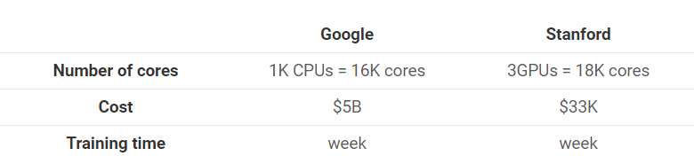
How Fast GPU vs. CPU?
There are a lot of misunderstanding and black marketing:
What is a core on GPU?
Are CPU and GPU cores are comparable?

Slide 19
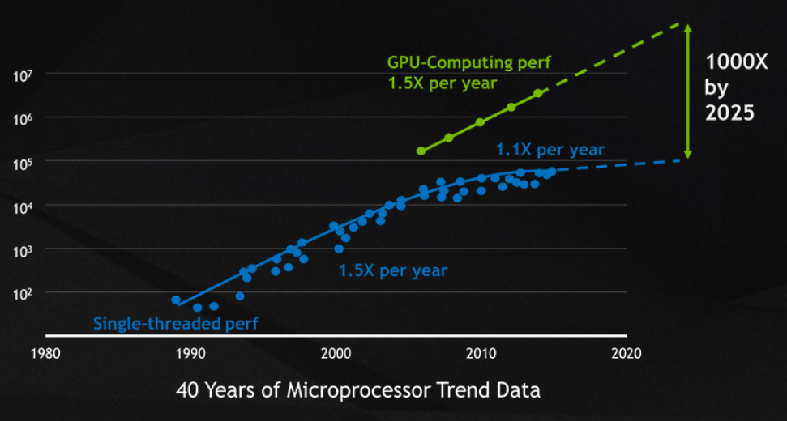
How Fast GPU vs. CPU?
There are a lot of misunderstanding and black marketing:
Need to compare with throughput applications on many cores

Slide 20
How Fast GPU vs. CPU?
 | 2080 Ti (Turing), 2017Y | Xeon 8168 (Skylake), 2017Y | GPU / CPU
Cores
4352
24
181x
Compute capacity
14 TFLOPS (FP32)
~3 TFLOPS (FP32)
5x
110 TFLOPS (FP16 tensor cores)
36x
Memory BW
616 GB/s
120 GB/s
5x
Area
754 mm2
694 mm2
~1x
Price
1000$
6000x
6x
It is reasonable to say that GPU is up to ~10x faster than CPU (36x for ML)
Myth: GPU will make your applications 1000x faster

Slide 21
GPGPU Programming
There are many GPGPU APIs for C/C++:
CUDA: many features, easy-to-use, but not open and not portable (only NVIDIA)
OpenCL: less features, verbose, but open and portable (Intel, AMD, NVIDIA, etc.)
SYCL: based on OpenCL, easy-to-use, more C++ oriented, but still in development
All APIs are based on the offload model: host (CPU) prepares and controls everything, device (GPU) only execute
Code is divided in the two parts:
the device code (kernel) written in a subset of C/C++
the host code in your C/C++ program

Slide 22
Kernel Code (Open CL)
How to program this crazy mix of vectors and threads?
Big Idea: as it is SIMD, write code for a single data element only
The kernel compiler forms vectors and create threads on its own
Traditional Loop
Data parallel OpenCL
void
mul(const float *a,
const float *b,
float *c,
const int n)
{
for (int i = 0; i < n; i++)
c[i] = a[i] * b[i];
}
__kernel void
mul(__global const float *a,
__global const float *b,
__global float *c)
{
int i = get_global_id(0);
c[i] = a[i] * b[i];
}
t0
t1
t2
…
tK
…
tK+1
tK+2
EU0

Slide 23
Kernel Code (Open CL)
→ in toy examples – yes, but not in the real world
Is everything so simple?
Problem: Divergent control flow decreases utilization
__kernel void
foo(__global const float *a,
__global const float *b,
__global float *c)
{
int i = get_global_id(0);
if (i % 2)
c[i] = a[i] * a[i];
else
c[i] = b[i] * b[i];
}
half of elements is calculated, but dropped
mask = {0, 1, 0, 1, 0, 1, 0, 1} c[0:7] = vmul a[0:7], a[0:7], mask
c[0:7] = vmul b[0:7], b[0:7], !mask

Slide 24
Kernel Code (Open CL)
→ in toy examples – yes, but not in the real world
Is everything so simple?
Problem: Divergent control flow decreases utilization
Problem: Tuning for GPU layout is required
Hand on OpenCL Workshop, UoB-HPC, 2018
Matrix Multiplication Approaches | GFLOP/s
 | CPU | GPU
Sequential C (not OpenCL) | 0.85 | N/A
C(i,j) per work-item, all global | 111.8 | 70.3
C row per work-item, all global | 61.8 | 9.1
C row per work-item, A row private | 9.6 | 24.9
C row per work-item, A private, B local | 12.3 | 55.4
Block oriented approach using local | 138.0 | 1,801.8
Graphic Pipeline
EU
EU
EU
EU
EU
EU
EU
EU
EU
EU
EU
EU
EU
EU
EU
EU
EU
EU
EU
EU
EU
EU
EU
EU
EU
EU
EU
EU
EU
EU
EU
EU
EU
EU
EU
EU
Compute
Dispatch
L1
L1
L1
L2
Myth: It is much easier to write high-performance code for GPU than for CPU
11.5% of peak
21.2% of peak

Slide 25
Conclusions
5-10x speedup is good to invest
APIs are mature for production, but still evolve
Entry threshold is medium
Writing high-performance code is as hard as on CPU

Slide 26
Many thanks!
Questions welcome :)
Alexander Titov
alexander.titov@atitov.com
alexander-titov-cpu

